Slide 1
Desktop Baymax
Gaurav, Namrita, Abhy, Charles, Emily, Christine

Slide 2
Purpose
Make an upper body endoskeleton that mimics hugging action
Place this frame inside an outer skin cover that resembles Baymax
Incorporate sensory input and watch Baymax hug you!!

Slide 3
Revising our Purpose
Make a smaller scale baymax using smaller servos that are more compatible with Arduino
Place arm skeleton into plushie baymax
Incorporate the arduino, breadboard, and wires into the suit to make baymax look more aesthetically pleasing
Result in desktop baymax, allowing him to hug at the push of a button!

Slide 4
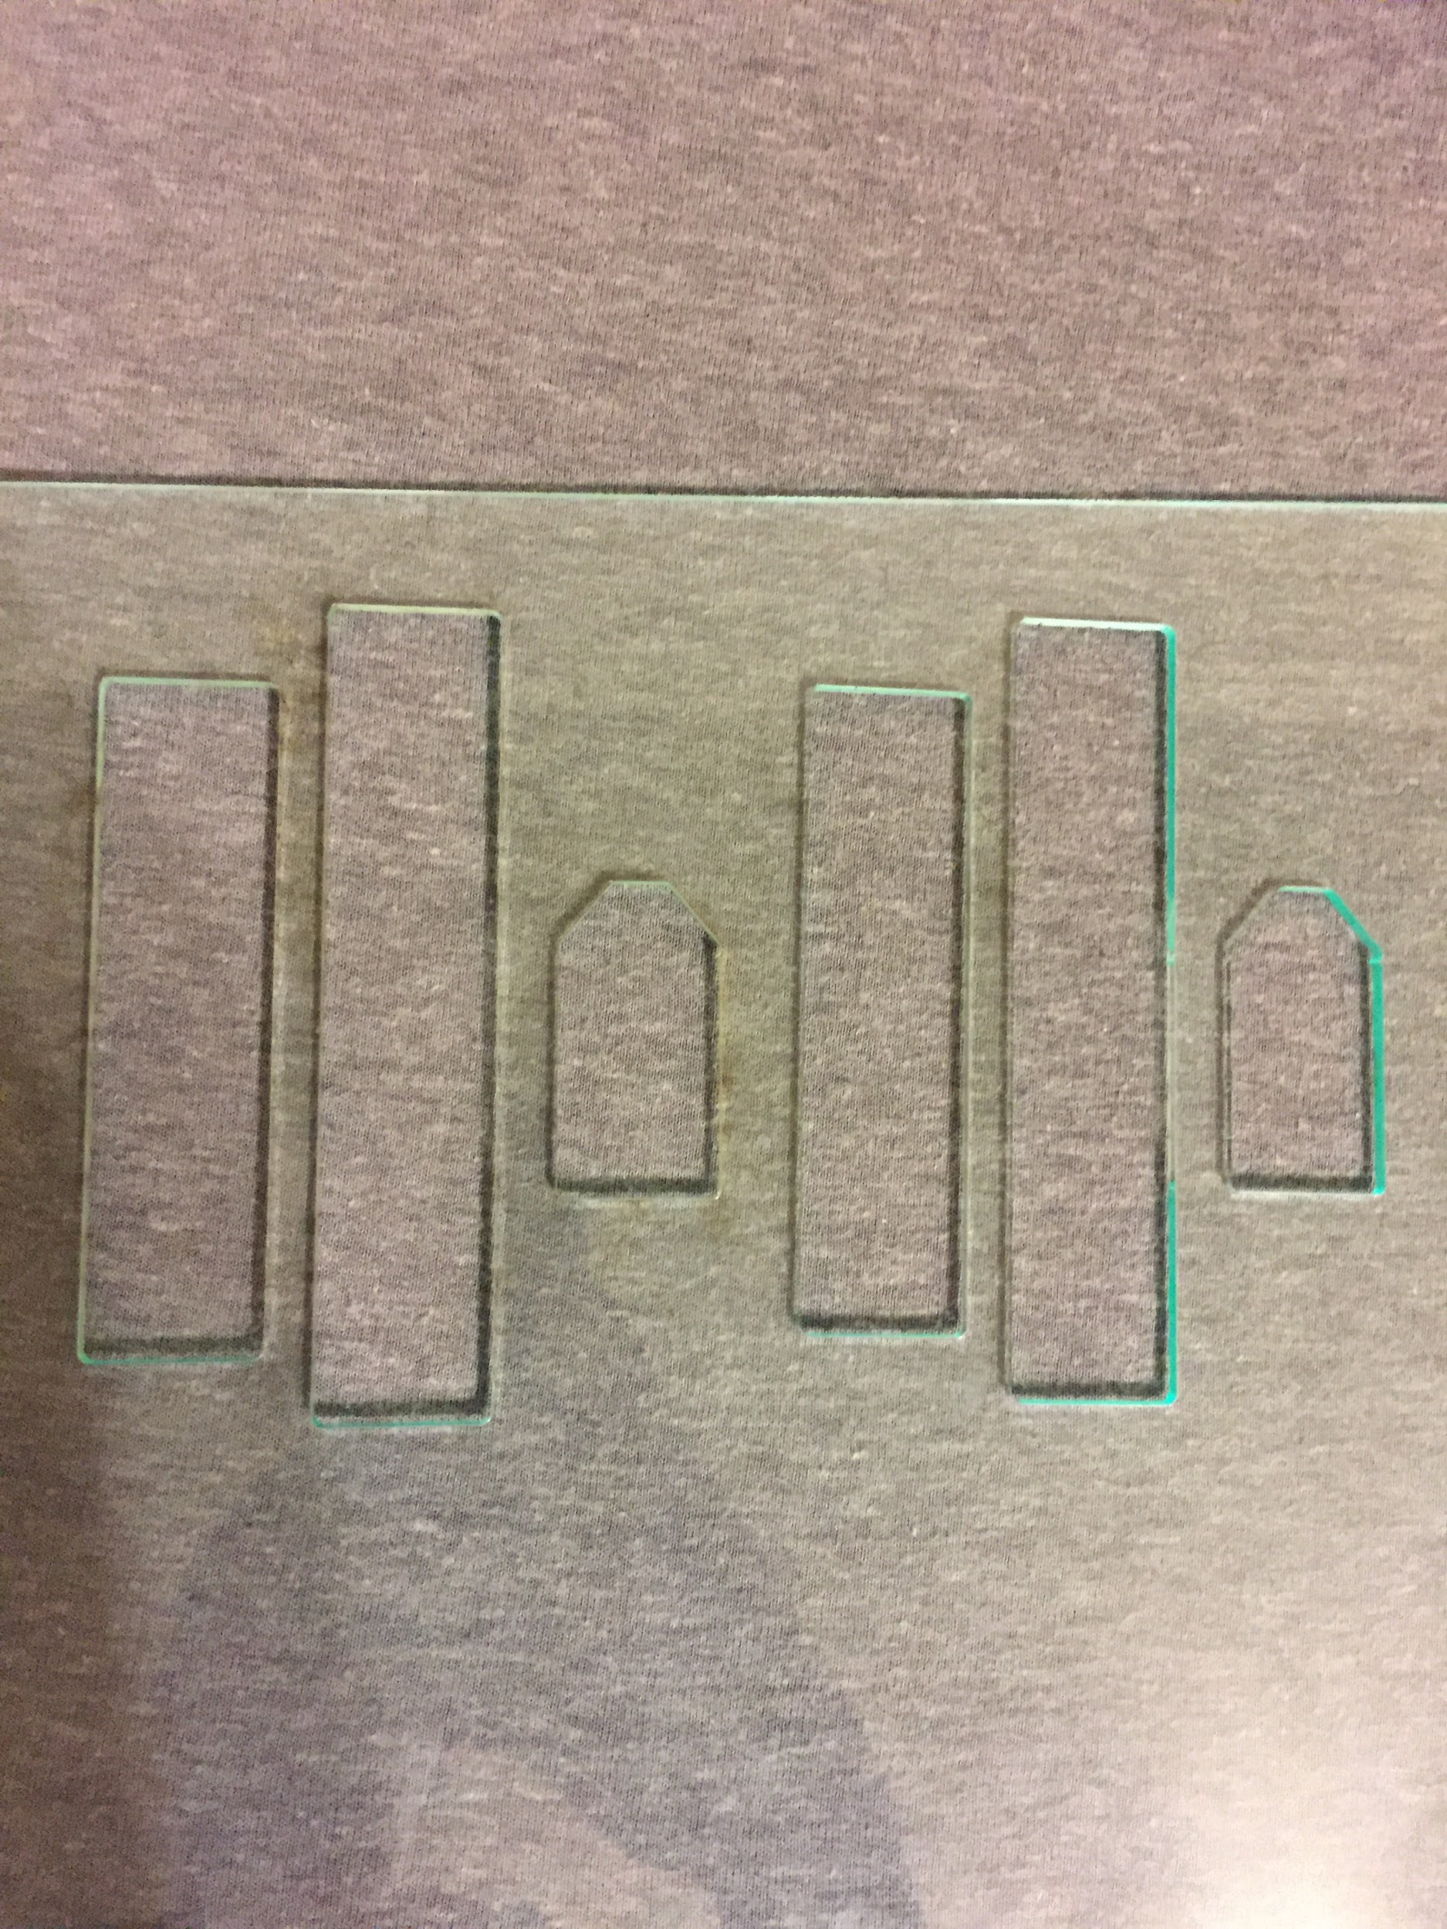
Progress
Our initial progress helped us to figure out the speeds and durations for turning the servos to mimic a hugging action.
Since then:
Laser cut acrylic pieces to construct more stable, powerful arms

Slide 5
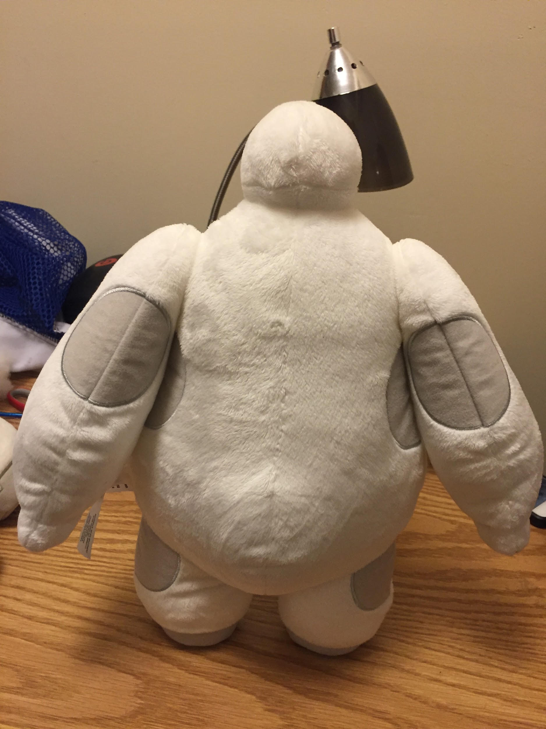
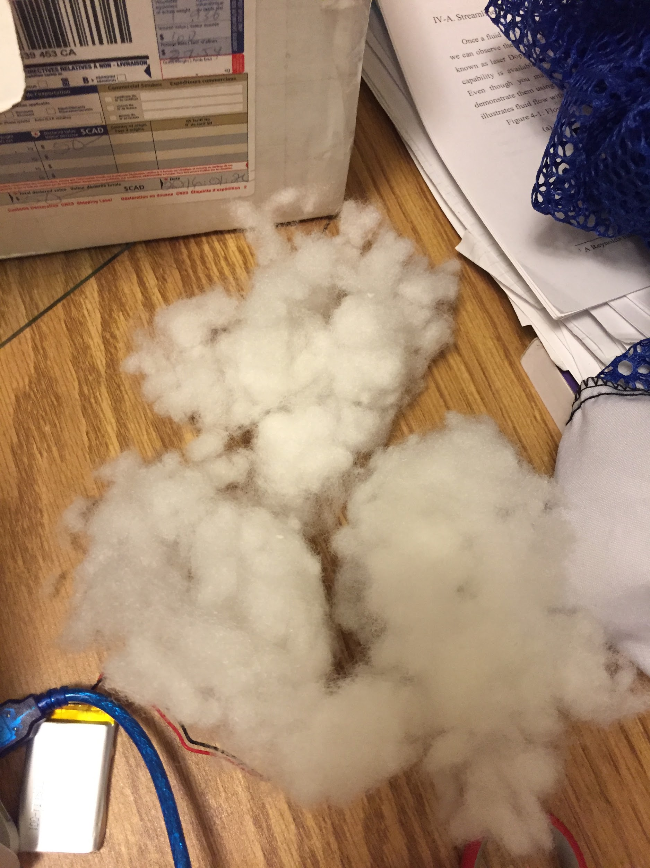
Progress
Our initial progress helped us to figure out the speeds and durations for turning the servos to mimic a hugging action.
Since then:
Purchased upper body suit depicting Baymax and unstuffed cotton from arms

Slide 6
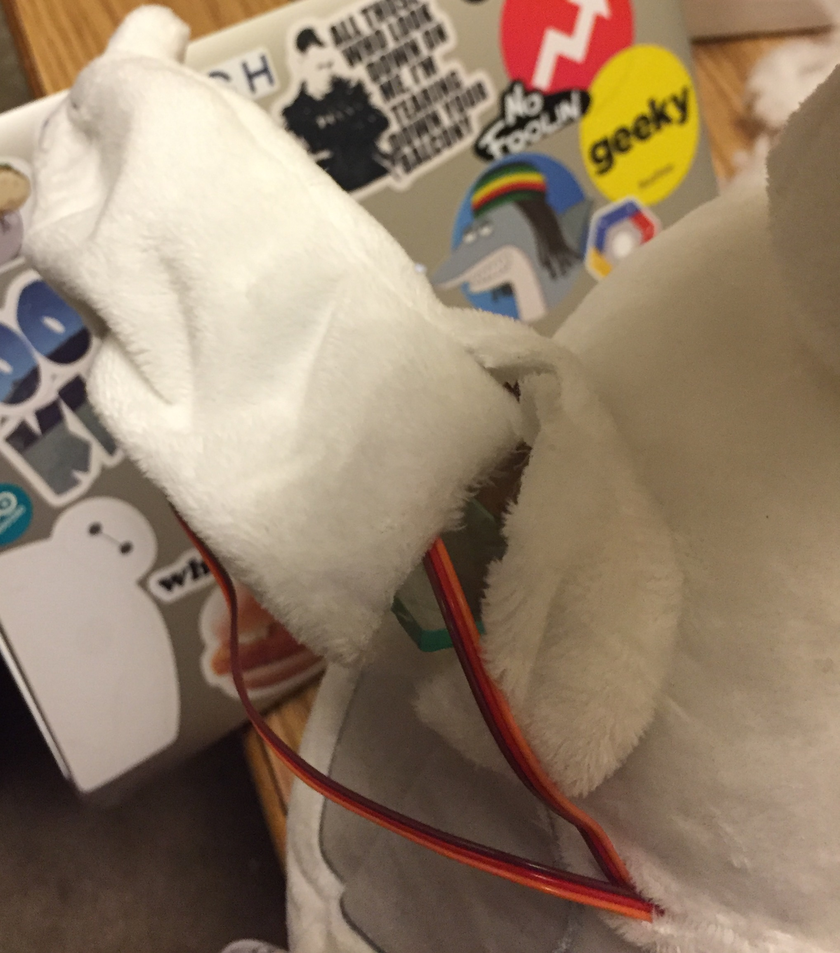
Progress
Our initial progress helped us to figure out the speeds and durations for turning the servos to mimic a hugging action.
Since then:
Created 2 arms by attaching servos onto the acrylic and inserted into Baymax

Slide 7
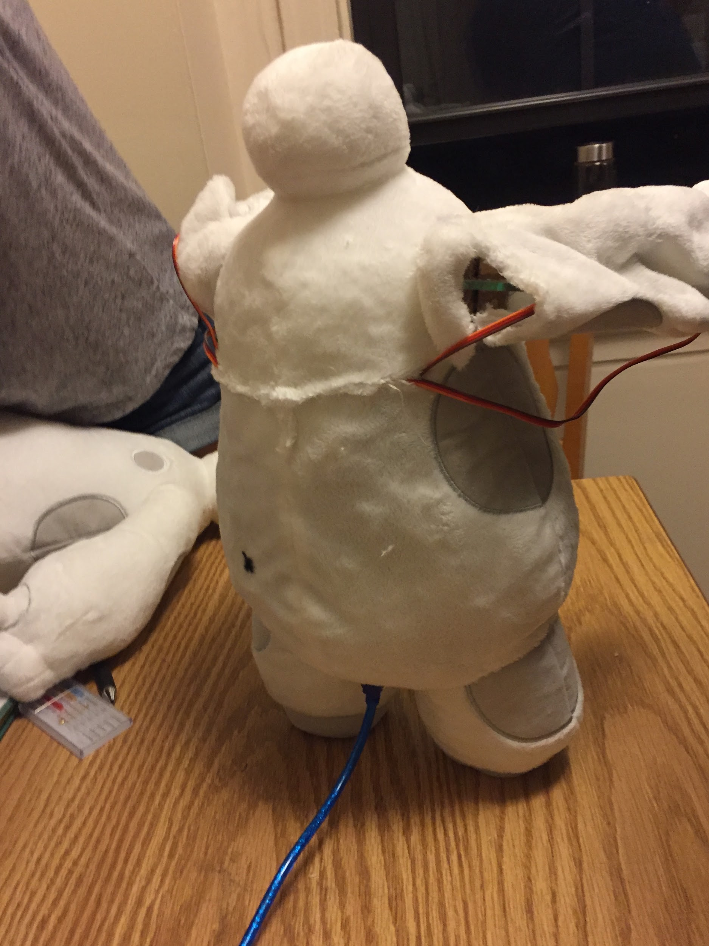
Progress
Our initial progress helped us to figure out the speeds and durations for turning the servos to mimic a hugging action.
Since then:
Cut slits to enable wires to be easily weaved into fabric and somewhat hidden

Slide 8
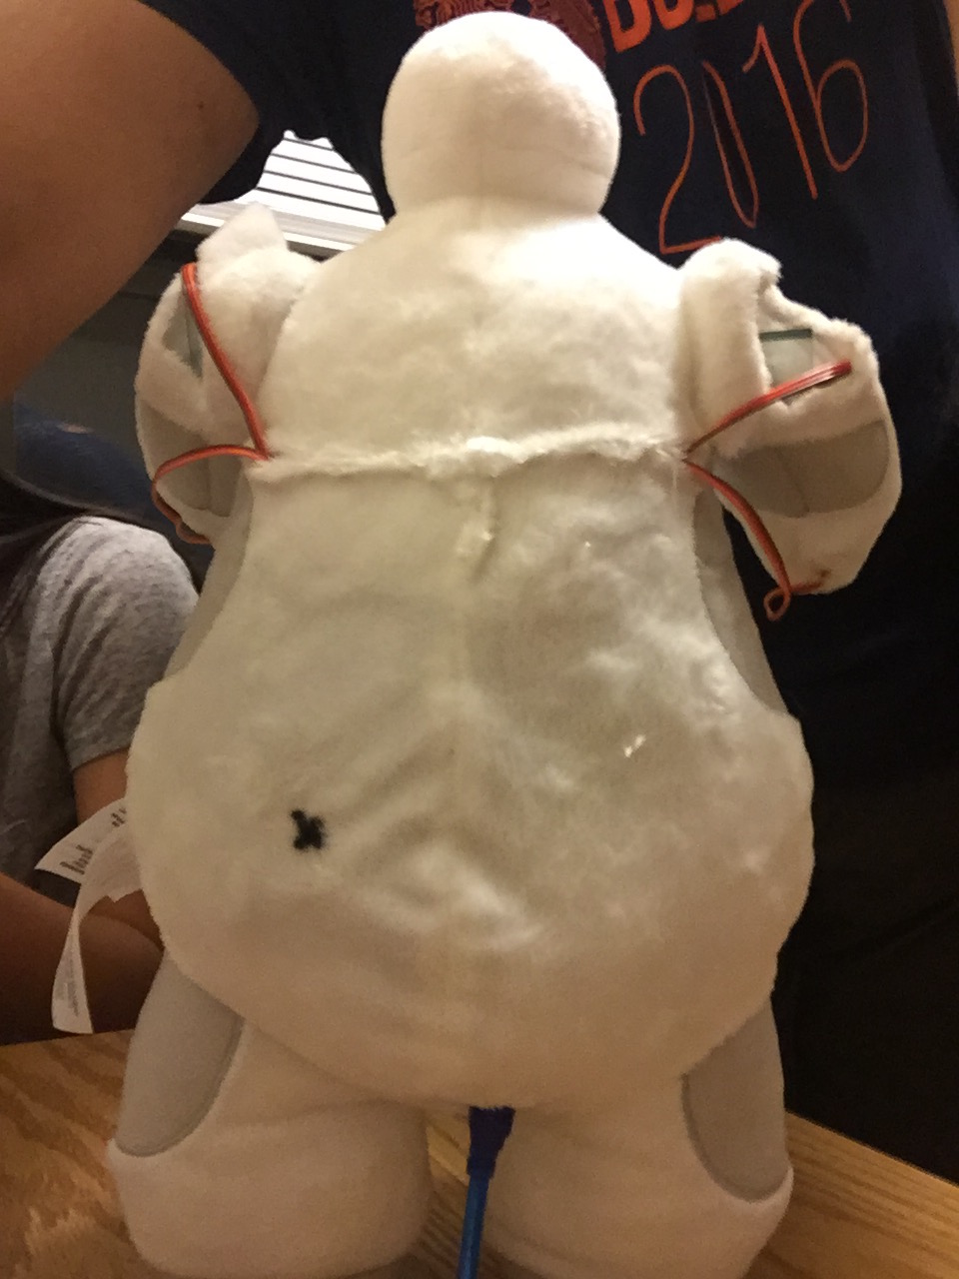
Progress
Our initial progress helped us to figure out the speeds and durations for turning the servos to mimic a hugging action.
Since then:
Created pouch to insert Arduino/breadboard to hide all electronics (aesthetics)

Slide 9
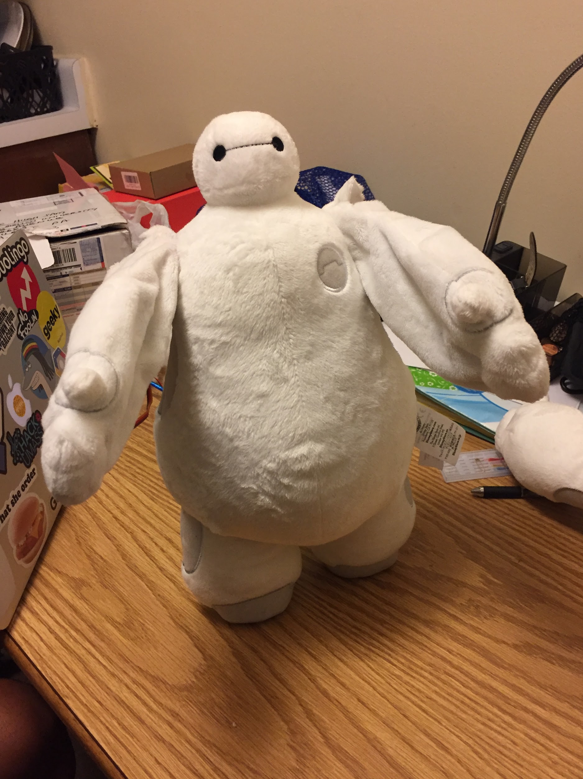
Progress
Our initial progress helped us to figure out the speeds and durations for turning the servos to mimic a hugging action.
Since then:
Created full-fledged desktop baymax that hugs at a press of a button!

Slide 10
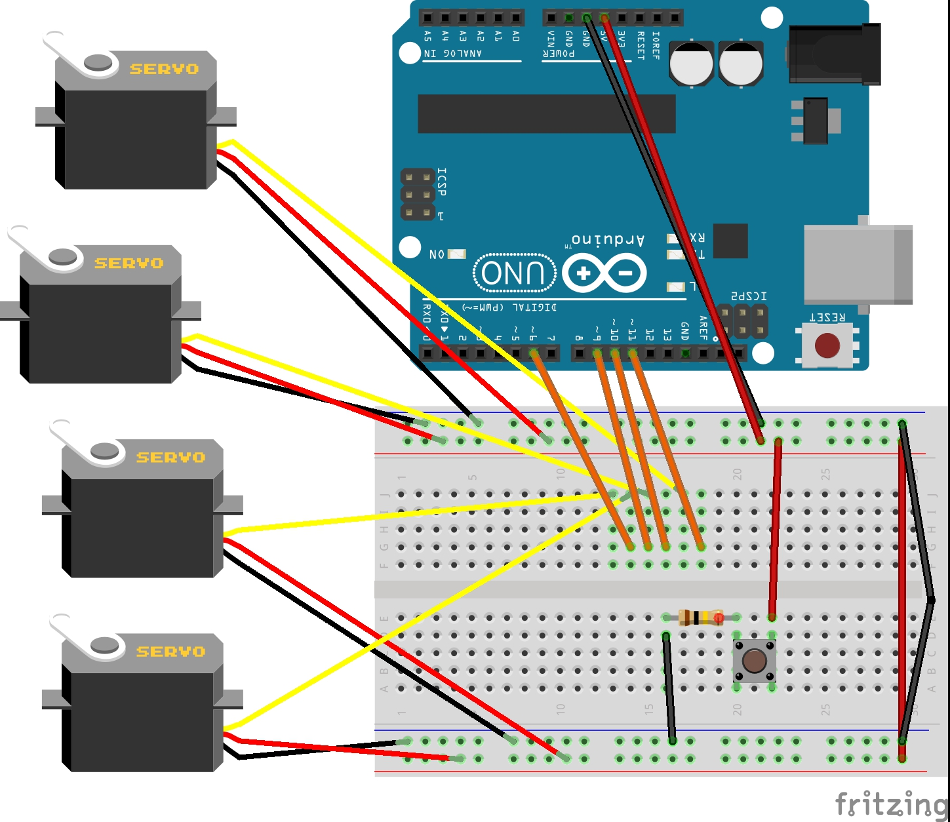
Circuit

Slide 11
Problems
Issues with Dynamixel AX-12A servos incompatibility with serial port/Arduino
Arms were too heavy to use small servos for shoulder axis
Big servos occupy too much space inside suit
Tension at certain places in baymax’s skin would prevent arm movement

Slide 12
https://drive.google.com/open?id=0BzX2pMBIznCINGd2REIzQnlRQ0E
https://drive.google.com/open?id=0BzX2pMBIznCIbzllRGVMNVI3SWM
https://drive.google.com/open?id=0BzX2pMBIznCITVJlMGdHazVPQjg
https://drive.google.com/open?id=0BzX2pMBIznCIcHhiSHJ3TW1DT1E

Slide 13
Next Steps
Add additional battery packs to power Baymax without laptop
Incorporate sensors, vision, or voice control to activate hugging
Enable Baymax to perform other interactions such as waving and handshaking

Slide 14
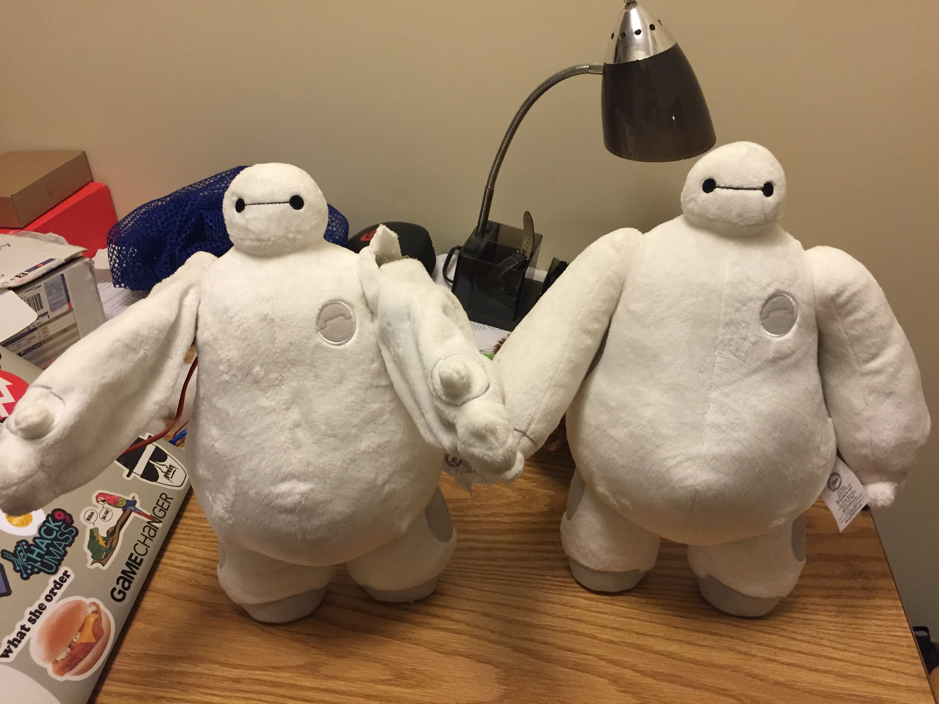
Thanks for watching!!!

